Slide 1
3gr 7. labor
Plakátok, részecskerendszerek
Szécsi László

Slide 2
Particle osztály (Game-ben)
#include "Math/math.h"
class Particle {
Egg::Math::float3 position;
Egg::Math::float3 velocity;
float lifespan;
float age;
public:
};

Slide 3
Particle osztály
void reborn() {
using namespace Egg::Math;
position =
float3::random(-1,1);
velocity = position * 5;
age = 0;
lifespan = float1::random(2,5);
}
Particle(){ reborn(); }

Slide 4
Particle buffer, input layout és pass
Lehetne ezeket kézzel létrehozni
ugyanúgy, ahogy a háromszögrajzolásnál az elején
de a VB használati módja dinamikus
rajzoláskor így lenne
context->IASetPrimitiveTopology( D3D11_PRIMITIVE_TOPOLOGY_POINTLIST);
context->Draw(particles.size(), 0);

Slide 5
Egg::Mesh-t használva
Mesh::VertexStream a geometria
shaderekből Mesh::Material
InputLayout gyártása a Mesh::Binder feladata
a végén kapunk egy Mesh::Shaded-et amit csak ki kell rajzolni
beállítja a shadereket (+más anyagos dolgokat)
az input layoutot
a vertex buffert
rajzol

Slide 6
Game.h
#include <vector>

Slide 7
Game.h
class Game : public Egg::App
{
std::vector<Particle> particles;
Egg::Mesh::Shaded:P
fireBillboardSet;
com_ptr<ID3D11Buffer>
perSwapChainConstantBuffer;

Slide 8
Game::Game
for(uint i=0; i<40; i++)
particles.push_back(Particle());

Slide 9
createResources
D3D11_INPUT_ELEMENT_DESC particleElements[3];
particleElements[0].AlignedByteOffset = offsetof(Particle, position);
particleElements[0].Format = DXGI_FORMAT_R32G32B32_FLOAT;
particleElements[0].InputSlot = 0;
particleElements[0].InputSlotClass = D3D11_INPUT_PER_VERTEX_DATA;
particleElements[0].InstanceDataStepRate = 0;
particleElements[0].SemanticIndex = 0;
particleElements[0].SemanticName = "POSITION";
particleElements[1].AlignedByteOffset = offsetof(Particle, lifespan);
particleElements[1].Format = DXGI_FORMAT_R32_FLOAT;
particleElements[1].InputSlot = 0;
particleElements[1].InputSlotClass = D3D11_INPUT_PER_VERTEX_DATA;
particleElements[1].InstanceDataStepRate = 0;
particleElements[1].SemanticIndex = 0;
particleElements[1].SemanticName = "LIFESPAN";
particleElements[2].AlignedByteOffset = offsetof(Particle, age);
particleElements[2].Format = DXGI_FORMAT_R32_FLOAT;
particleElements[2].InputSlot = 0;
particleElements[2].InputSlotClass = D3D11_INPUT_PER_VERTEX_DATA;
particleElements[2].InstanceDataStepRate = 0;
particleElements[2].SemanticIndex = 0;
particleElements[2].SemanticName = "AGE";

Slide 10
createResources
Egg::Mesh::VertexStreamDesc particleBufferDesc;
particleBufferDesc.elements = particleElements;
particleBufferDesc.nElements = 3;
particleBufferDesc.nVertices = particles.size();
particleBufferDesc.vertexStride = sizeof(Particle);
particleBufferDesc.vertexData = &particles.at(0);
particleBufferDesc.cpuAccessFlags = D3D11_CPU_ACCESS_WRITE;
particleBufferDesc.usage = D3D11_USAGE_DYNAMIC;

Slide 11
createResources
Egg::Mesh::VertexStreamP
particleVertexStream =
Egg::Mesh::VertexStream::create(
device,
particleBufferDesc);

Slide 12
billboard.hlsli
struct IaosBillboard {
float3 pos : POSITION;
float lifespan : LIFESPAN;
float age : AGE;
};
typedef IaosBillboard VsosBillboard;
struct GsosBillboard {
float4 pos : SV_Position;
float2 tex : TEXCOORD;
};
cbuffer perSwapChain{
float4 billboardSize;
}

Slide 13
vsBillboard.hlsl
VsosBillboard vsBillboard(IaosBillboard input)
{
return input;
}

Slide 14
gsBillboard.hlsl
[maxvertexcount(4)]
void gsBillboard(
point VsosBillboard input[1],
inout TriangleStream<GsosBillboard> stream) {
float4 hndcPos = mul(float4(input[0].pos, 1),
modelViewProjMatrix);
GsosBillboard output;
output.pos = hndcPos;
output.pos.x += billboardSize.x;
output.pos.y += billboardSize.y;
output.tex = float2(1, 0);
stream.Append(output);
output.pos = hndcPos;
output.pos.x += billboardSize.x;
output.pos.y -= billboardSize.y;
output.tex = float2(1, 1);
stream.Append(output);
output.pos = hndcPos;
output.pos.x -= billboardSize.x;
output.pos.y += billboardSize.y;
output.tex = float2(0, 0);
stream.Append(output);
output.pos = hndcPos;
output.pos.x -= billboardSize.x;
output.pos.y -= billboardSize.y;
output.tex = float2(0, 1);
stream.Append(output); }

Slide 15
psFire.hlsl
float4 psFire(GsosBillboard input) : SV_Target
{
return input.tex.xyyy;
}

Slide 16
createResources
com_ptr<ID3DBlob> billboardVertexShaderByteCode = loadShaderCode("vsBillboard.cso");
Egg::Mesh::ShaderP billboardVertexShader = Egg::Mesh::Shader::create(device, billboardVertexShaderByteCode);
com_ptr<ID3DBlob> billboardGeometryShaderByteCode = loadShaderCode("gsBillboard.cso");
Egg::Mesh::ShaderP billboardGeometryShader = Egg::Mesh::Shader::create(device, billboardGeometryShaderByteCode);
com_ptr<ID3DBlob> firePixelShaderByteCode = loadShaderCode("psFire.cso");
Egg::Mesh::ShaderP firePixelShader = Egg::Mesh::Shader::create(device, firePixelShaderByteCode);

Slide 17
createResources
com_ptr<ID3D11Resource> bbTexture;
com_ptr<ID3D11ShaderResourceView> bbSrv;
std::wstring bbfile = Egg::UtfConverter::utf8to16(App::getSystemEnvironment()
.resolveMediaPath("particle.dds"));
Egg::ThrowOnFail("Could not create particle texture and/or SRV.", __FILE__, __LINE__) ^
DirectX::CreateDDSTextureFromFile(device.Get(),
bbfile.c_str(),
bbTexture.GetAddressOf(), bbSrv.GetAddressOf());

Slide 18
createResources
Egg::Math::float4 billboardSize(.1, .1, 0, 0);
D3D11_SUBRESOURCE_DATA initialBbSize;
initialBbSize.pSysMem = &billboardSize;
constantBufferDesc.ByteWidth = sizeof(Egg::Math::float4) * 1;
Egg::ThrowOnFail("Failed to create per frame constant buffer.", __FILE__, __LINE__) ^
device->
CreateBuffer(&constantBufferDesc,
&initialBbSize, perSwapChainConstantBuffer.GetAddressOf());

Slide 19
createResources
Egg::Mesh::Material::P fireMaterial
= Egg::Mesh::Material::create();
/* feladat: shaderek, constant bufferek, textúra bekötése */
ComPtr<ID3D11InputLayout> billboardInputLayout =
inputBinder->getCompatibleInputLayout(
billboardVertexShaderByteCode,
particleVertexStream);
fireBillboardSet = Egg::Mesh::Shaded::create(
particleVertexStream, fireMaterial,
billboardInputLayout);

Slide 20
releaseResources
fireBillboardSet.reset();

Slide 21
render
fireBillboardSet->draw(context);

Slide 22
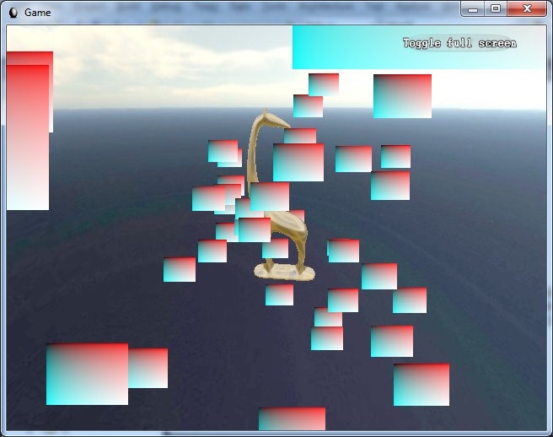
Színes plakátok

Slide 23
Textúra
Projects/gg011-Particles/Media/particle.dds

Slide 24
createResources
// DirectX::CreateDDSTextureFromFile
fireMaterial->
setShaderResource(
"billboardTexture",
particleSrv);

Slide 25
psBillboard.hlsl
Texture2D billboardTexture;
float4 psFire(GsosBillboard input) : SV_Target
{
return billboardTexture.Sample(
linearSampler,
input.tex.xy);
}

Slide 26
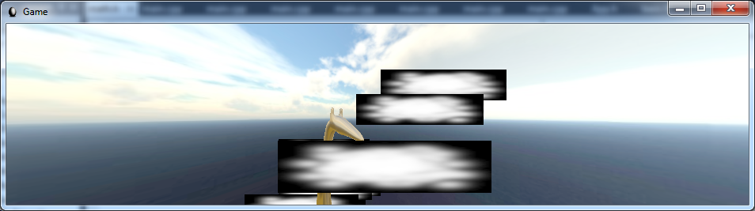
Textúrázott, de viewporthoz torzuló

Slide 27
createSwapChainResources
using namespace Egg::Math;
float4 worldBillboardSize(0.2, 0.2, 0, 0);
float4 screenBillboardSize =
worldBillboardSize
* firstPersonCam->getProjMatrix();
context->
UpdateSubresource(
perSwapChainConstantBuffer.Get(), 0, nullptr, &screenBillboardSize, 0, 0);

Slide 28
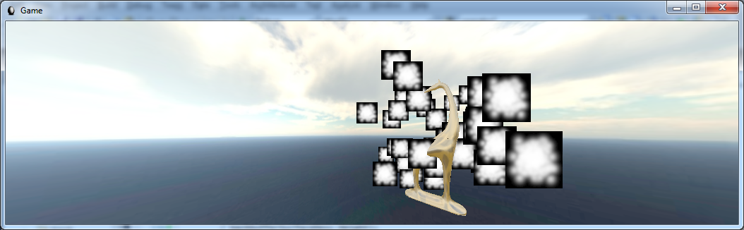
Állandó méretű plakátok

Slide 29
Alpha blending
BlendState-et kell létrehozni, material-ban beállítani
device createBlendState

Slide 30
hasznos blend állapotok (fx syntax, nem copyzható)
BlendState defaultBlender
{
};
BlendState additiveBlender
{
BlendEnable[0] = true;
SrcBlend = src_alpha;
DestBlend = one;
BlendOp = add;
SrcBlendAlpha = one;
DestBlendAlpha = one;
BlendOpAlpha = add;
};

Slide 31
egyéb raszter állapotok (fx syntax, nem copyzható)
RasterizerState defaultRasterizer
{
};
RasterizerState noCullRasterizer
{
CullMode = none;
FillMode = solid;
};
RasterizerState backfaceRasterizer
{
CullMode = front;
FillMode = solid;
};
RasterizerState wireframeRasterizer
{
CullMode = none;
FillMode = wireFrame;
};

Slide 32
hasznos mélység állapotok (fx syntax, nem copyzható)
DepthStencilState defaultCompositor
{
};
DepthStencilState noDepthTestCompositor
{
DepthEnable = false;
DepthWriteMask = zero;
};
DepthStencilState noDepthWriteCompositor
{
DepthEnable = true;
DepthWriteMask = zero;
};

Slide 33
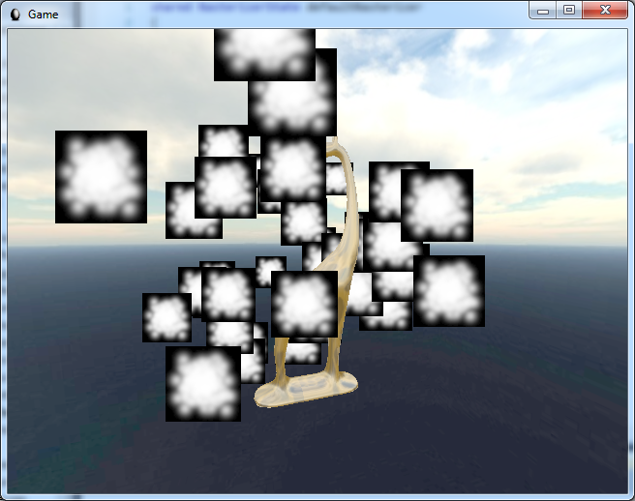
Előtte

Slide 34
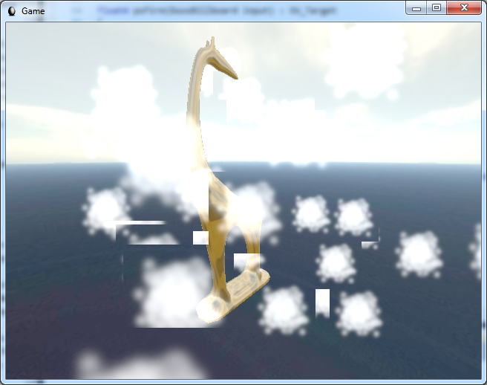
Additive blenderrel… de z-teszt is van

Slide 35
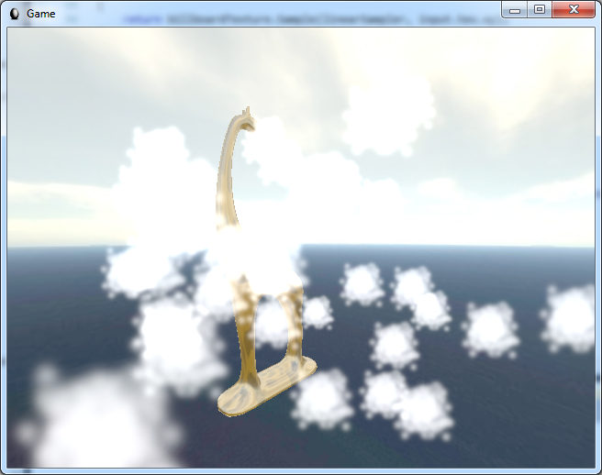
Nincs depth test – zsiráf sem takar

Slide 36
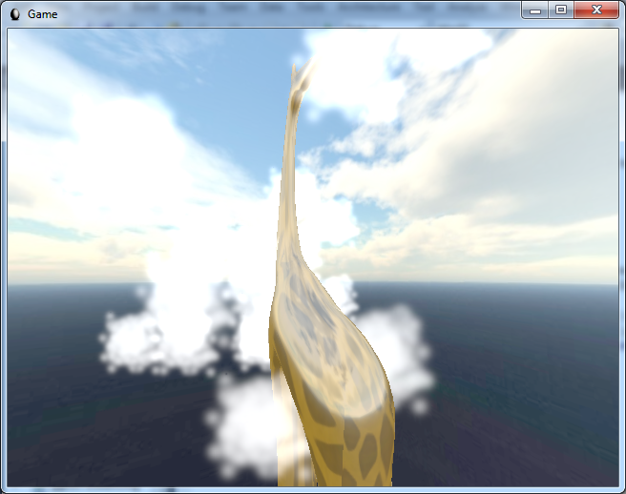
Z-teszt van, mélységírás nincs: Zsiráf takar, plakát nem

Slide 37
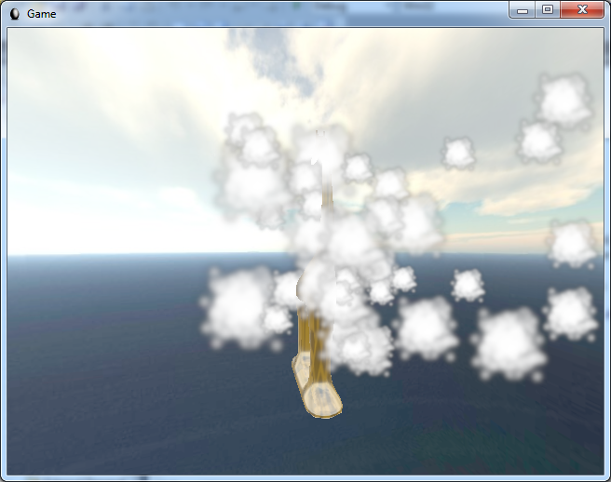
TransparencyBlender: Rossz a sorrend… hátsók takarnak előbbiekre
Ehhez rendezni kellene a plakátokat mélység szerint… egyelőre inkább vissza az additívhoz!

Slide 38
Legyen színesebb
float4 psFire(GsosBillboard input) : SV_Target
{
float4 color = billboardTexture.Sample(linearSampler, input.tex.xy);
color.rgb = float3( color.a,
pow(color.a, 4),
pow(color.a, 10));
return color;
}

Slide 39
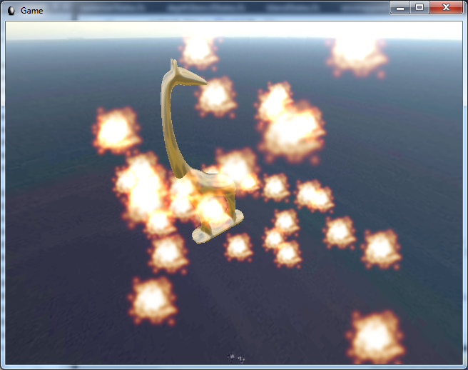
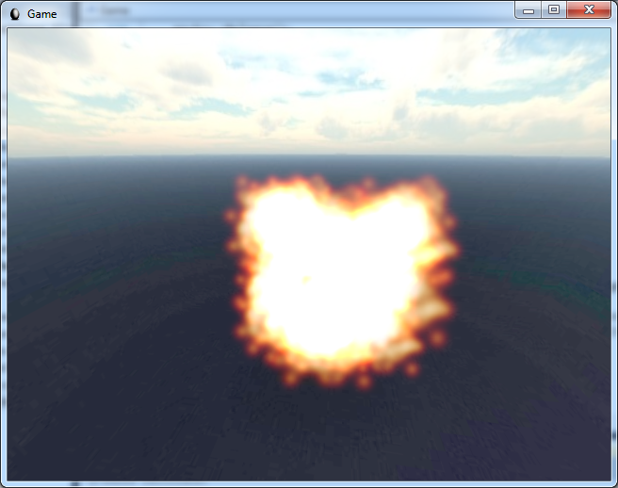
worldBillboardSize (1, 1)

Slide 40
Nagyobb tűz
using namespace Egg::Math;
firstPersonCam = Egg::Cam::FirstPerson::create()
->setView(
float3(0, 0, 200),
float3(0, 0, -1))
->setProj(1.2, 1, 1, 1000)
->setSpeed(50);
float4 worldBillboardSize(50.0, 50.0, 0, 0);

Slide 41
Particle
void move(float dt)
{
position +=velocity * dt;
age += dt;
if(age > lifespan)
reborn();
}

Slide 42
Game::animate
for(int i = 0; i < particles.size(); i++)
particles.at(i).move(dt);

Slide 43
Game::animate
auto vertexBuffer =
fireBillboardSet->getGeometry()->
getPrimaryBuffer();
ID3D11DeviceContext* context;
device->GetImmediateContext(&context);
D3D11_MAPPED_SUBRESOURCE mappedVertexData;
context->Map(vertexBuffer.Get(), 0, D3D11_MAP_WRITE_DISCARD, 0, &mappedVertexData);
memcpy(mappedVertexData.pData,
&particles.at(0), sizeof(Particle) *
particles.size());
context->Unmap(vertexBuffer.Get(), 0);
context->Release();

Slide 44
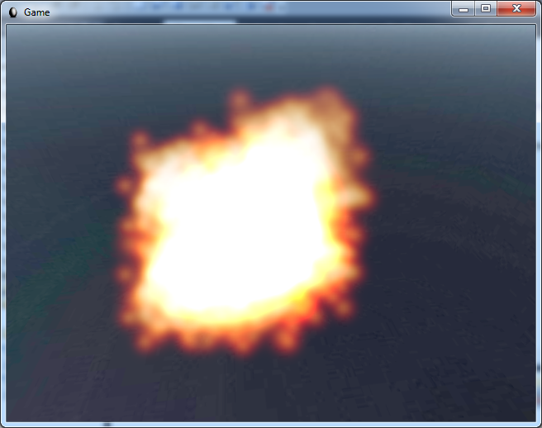
Hirtelen tűnnek el

Slide 45
Megoldás
Korfüggő méret, intenzitás és átlátszóság

Slide 46
gsBillboard
#9.0
struct GsosBillboard
{
float4 pos : SV_Position;
float2 tex : TEXCOORD;
float opacity : OPACITY;
};
float s = input[0].age / input[0].lifespan;
...
output.opacity = 1 - abs(s*2-1);
// és mindenhol szorozzuk s-sel a szélességet és magasságot

Slide 47
psFire
#9.0
float4 psFire(GsosBillboard input) : SV_Target
{
float4 color = billboardTexture.Sample(linearSampler, input.tex.xy);
color.rgb =
float3(color.a,
pow(color.a, 4),
pow(color.a, 10));
color.a *= input.opacity;
return color;
}

Slide 48
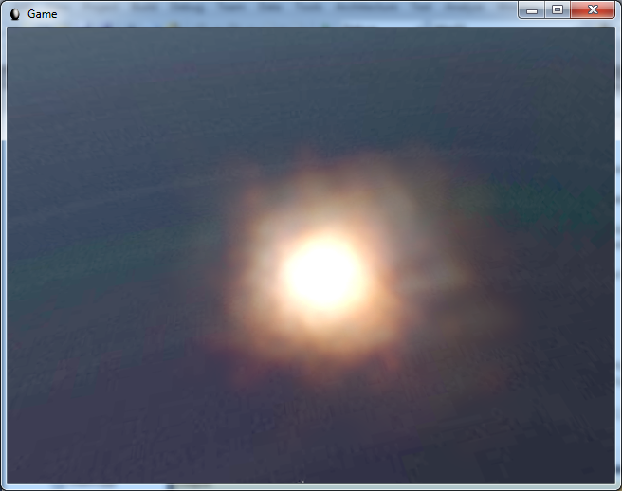
Simább tűz

Slide 49
Átlátszóság: transparencyBlender

Slide 50
animate - rendezés
using namespace Egg::Math;
struct CameraDepthComparator {
float3 ahead;
bool operator()(const Particle& a,
const Particle& b) {
return
a.position.dot(ahead) >
b.position.dot(ahead) + 0.01;
}
} comp = { firstPersonCam->getAhead() };
std::sort(particles.begin(), particles.end(), comp);

Slide 51
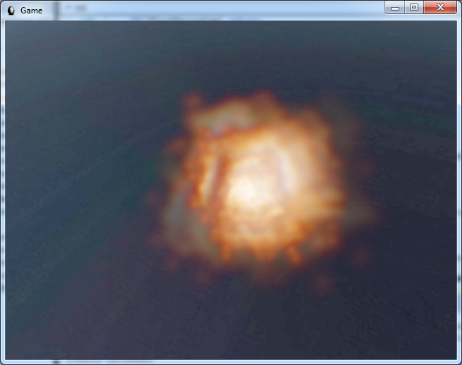
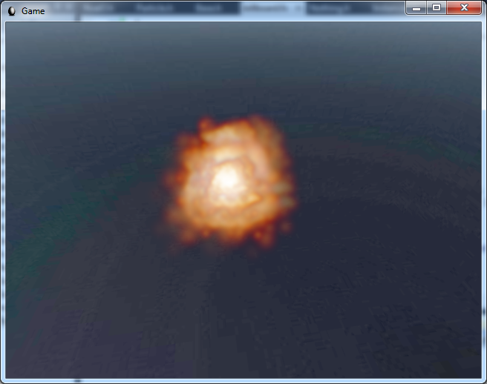
Rendezéssel szép

Slide 52
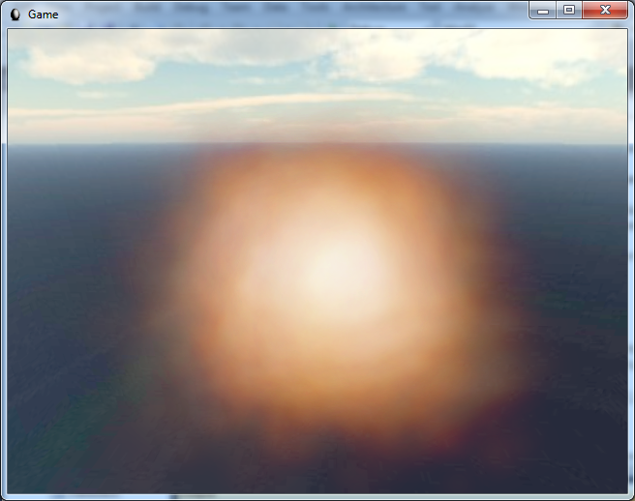
400 részecske, kisebb alfa

